Slide 1
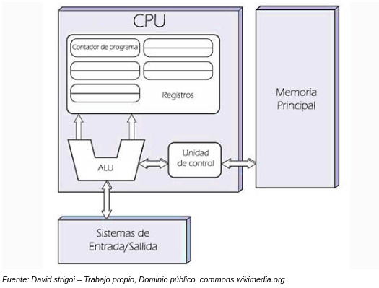
Von Neumann Architecture
The Von Neumann Architecture is a theoretical design for a computer to have a program stored internally, serving as the basis for almost all computers currently being made.
A Von Neumann Machine consists of a central processing unit, which includes an arithmetic logic unit and a control unit, as well as main memory, secondary storage, and input/output devices.

Slide 2
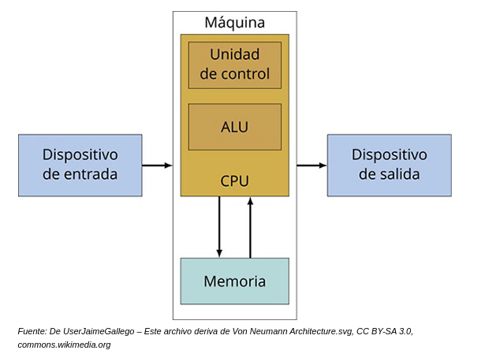
The main foundation of the Von Neumann Model is the thought that the program is stored internally in a machine. The memory unit contains the data and also the program code. The architecture design consists of:
Central Processing Unit (CPU)
Arithmetic Logic Unit (ALU)
Control Unit
Records
Memory
Input/Output
Bus
How does Von Neumann architecture work?
The relevant principle of the Von Neumann architecture is that both data and information are stored in memory
instructions and are treated the same, which means that instructions and data are directional.
It works using four simple steps:
Search
Decode
Run
Store

Slide 3
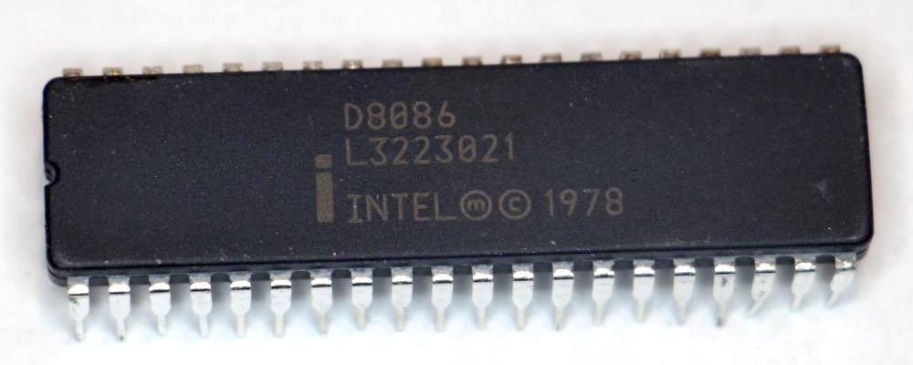
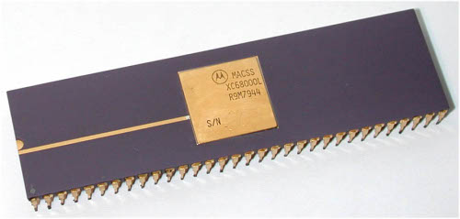
Architecture of a 16 and 32 bit processor
16 Bit-Architecture
16-bit architecture describes integers, memory addresses, or other data units that are up to 16 bits (2 octets) wide, or to refer to a register-based, address bus, or data bus architecture of CPUs and ALUs of that width.
The best known 16-bit processors are the PDP-11, Intel 8086, Motorola 68000, Intel 80286 y el WDC 65C816.

Slide 4
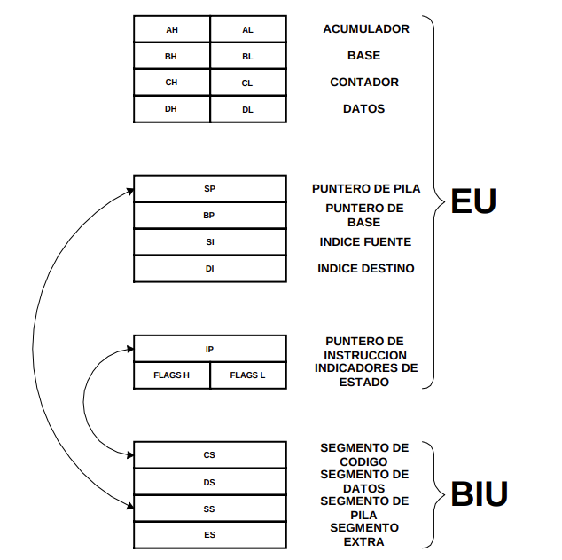
Architecture of the 8086.
This microprocessor is divided into two sub-processors.
On the one hand there is the "Execution Unit" (EU) in charge of executing the instructions, which has an ALU (arithmetic-logic unit) with a status register with various associated flags and a set of work registers, and on the other there is the "Bus Interface Unit" (BIU) in charge of searching for instructions, locating them in the instruction queue before their execution and facilitating memory addressing, that is, in charge of to access data and instructions from the outside world.
The 8086 contains 14 16-bit registers, some of which belong to the EU, which are normally used for addressing, and others belong to the BIU.
The 8086 registers could be classified into three groups according to their functions. The data set, which is essentially the set of arithmetic records; the pointer group, which includes the base and index registers and also the program counter and stack pointer; and the segment register group, which is a special purpose base register set. The group of data registers or general registers are 16-bit registers, each of them being able to be used as two 8-bit registers.

Slide 5
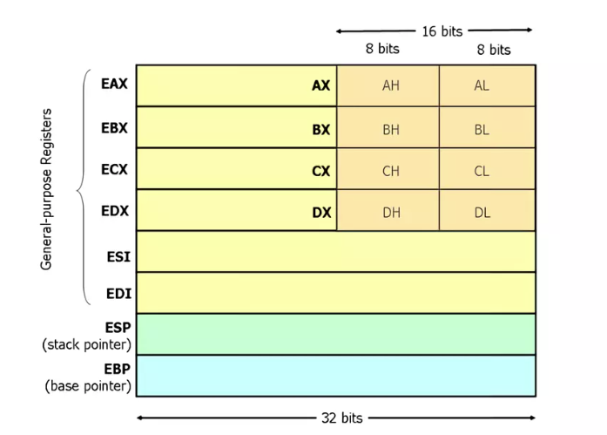
32-bit architecture
The first time Intel implemented a 32-bit version of the architecture was in the 80386.
Precisely Intel made a design decision regarding the registers of its processor quite ingenious: instead of creating new registers for the 32-bit mode, they extended the 16-bit ones.
The idea of using extended versions of the registers instead of new registers, is a way that Intel had to avoid having to duplicate the data paths of each instruction, on the one hand and on the other to not make the original set instructions incompatible. In this way they ensured that programs compiled for 16-bit x86 would work on later processors.
From the 80386 to the Intel Pentium, the data path of each instruction during the fetch and decode stages was the same, but Intel from the Pentium Pro onwards decided to re-make the data paths of all 32-bit, instructions to optimize its operation in contrast to 16-bit ones.

Slide 6
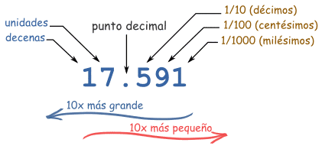
Decimal, binary and hexadecimal values.
Decimal Values
To understand binary and hexadecimal numbers, it's best to have a good understanding of how decimal numbers work.
Each digit of a decimal number goes in a "place", and the decimal point tells us what position each one is.
The position just to the left of the dot is the "units". Each time we move to the left it is worth 10 times more, and to the right it is worth 10 times less:
000
001
010 | no hay "2" en binario, así que volvemos al 0...... y sumamos 1 a la cifra de la izquierda
011
100 | volvemos otra vez al 0, y sumamos 1 a la izquierda...... pero ese número ya es 1 así que vuelve a ser 0...... y el 1 se suma al siguiente número a la izquierda
101
110 | etc...
Binary Values
Binary values are "base 2" instead of "base 10". You start by counting 0, then 1, when you run out of digits
it returns to 0, but the number on the left is increased by 1.

Slide 7
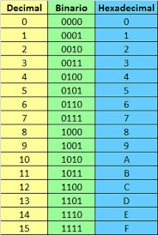
Hexadecimal Values:
Hexadecimal numbers are interesting. There are 16 different digits! They are like decimals up to 9, but after there are letters ("A',"B","C","D","E","F") for the values from 10 to 15. So with a single hexadecimal number 16 values can be given different ones instead of the usual 10:

Slide 8
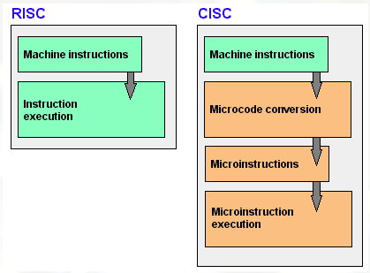
CISC and RISC architecture
One of the first decisions when designing a microprocessor is deciding what its instruction set will be.
Faced with this issue, there are two design philosophies; machines named CISC and machines named RISC.

Slide 9
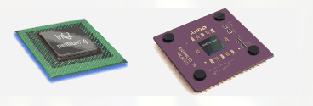
CISC architecture
CISC architecture (Complex Instruction Set Computer) is a model of computer architecture.
CISC microprocessors have an instruction set that is characterized by being very broad and allowing
complex operations between operands located in memory or internal registers, as opposed to the RISC architecture.
CISCs belong to the first stream of processor construction, before the development of RISCs.
Examples of them are: Motorola 68000, Zilog Z80 and all the Intel x86 family used in most personal computers.
current.
To carry out a single instruction, a CISC chip requires four to ten clock cycles.
The advantages of CISC include the following:
Reduces the difficulty of creating compilers.
Allows to reduce the total cost of the system.
Reduces software creation costs.
Improved code compaction.
Facilitates debugging.
Example of microprocessors based on CISC technology:
Intel 8086, 8088, 80286, 80386, 80486.
Motorola 68000, 68010, 68020, 68030, 6840.

Slide 10
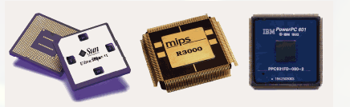
RISC architecture:
RISC architecture (Reduced Instruction Set Computer) is a type of microprocessor with the
following key features:
Instructions of fixed size and presented in a reduced number of formats.
Only the load and store instructions access the data memory.
The objective of designing machines with this architecture is to enable segmentation and parallelism in the execution of instructions.
and reduce memory accesses.
RISC machines are at the forefront of the current microprocessor building trend. PowerPC, DEC Alpha, MIPS, ARM,
SPARC… are examples of some of them.
Among the advantages of RISC we have the following:
The CPU works faster by using fewer clock cycles to execute instructions.
Uses a non-destructive address system in RAM. That means that unlike CISC, RISC preserves after
to carry out its operations in memory the two operands and their result, reducing the execution of new operations.
Each instruction can be executed in a single CPU cycle.
Example of microprocessors based on RISC technology:
MIPS, Millions Instruction Per Second.
PA-RISC, Hewlett Packard.
SPARC, Scalable Processor Architecture, Sun Microsystems.
POWER PC, Apple, Motorola and IBM.

